Slide 1
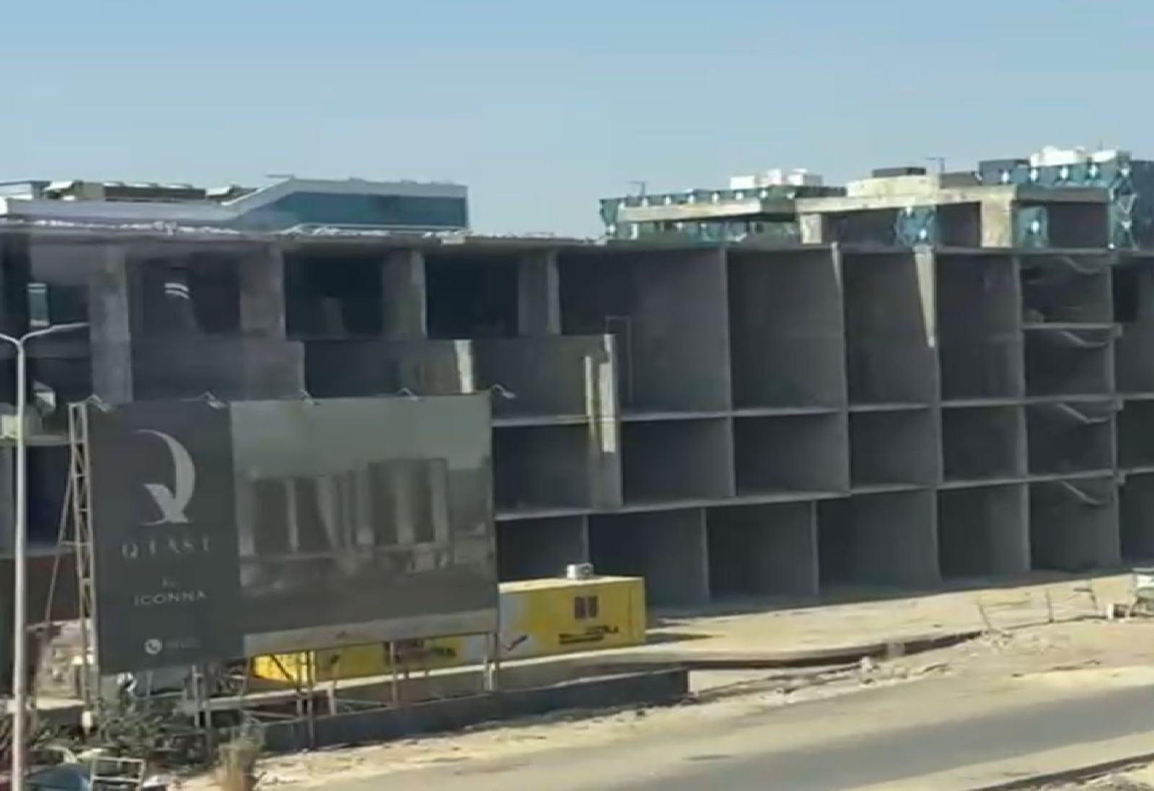
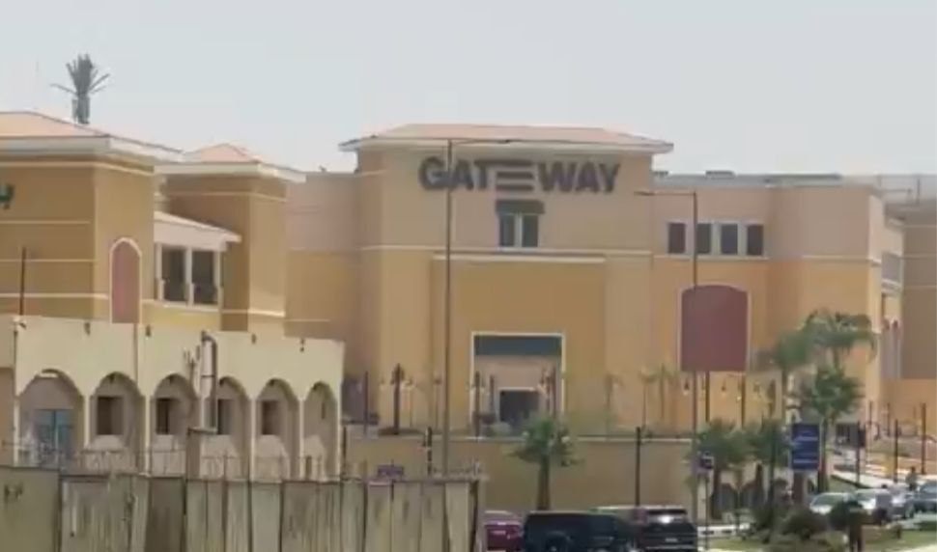
Building | Gate Way El Rehab
Delivery date | Ready to move
Gross area | 20 SQM Up TO 690 SQM
Hand over Condition | Furnished
Rent rate per meter | EGP 2,500
Maintenance | Included
Parking slots | Available
Upfront rent | 3 months
Security deposit | 3 months
Payment | Quarterly
Term | 3-5 years
Grace period | N\A
Annual increase | 10%
Commission | 1 month

Slide 2
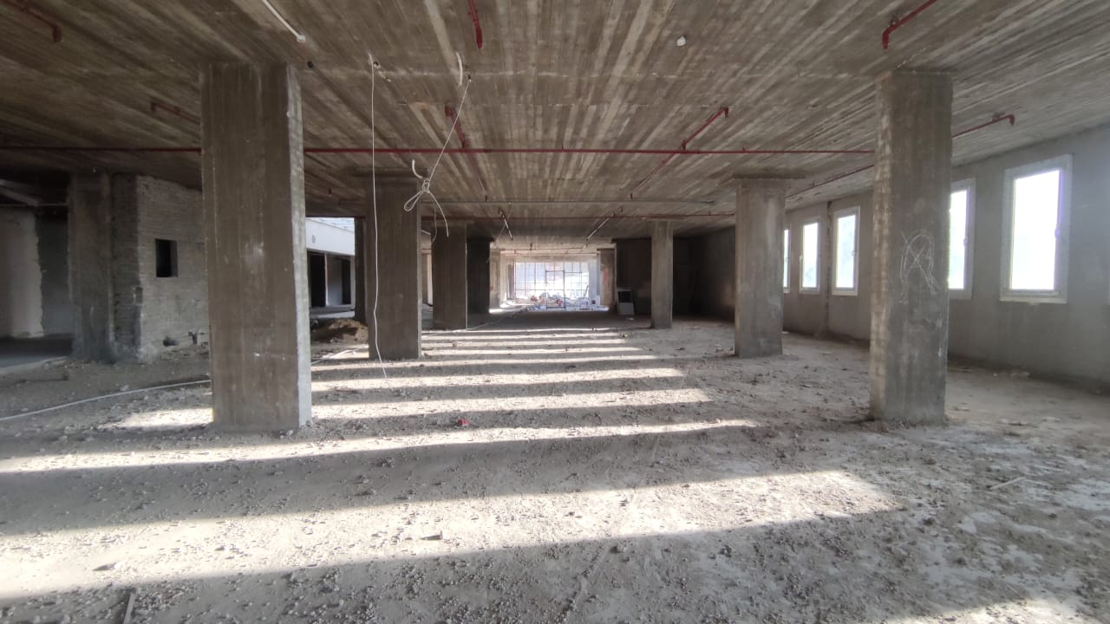
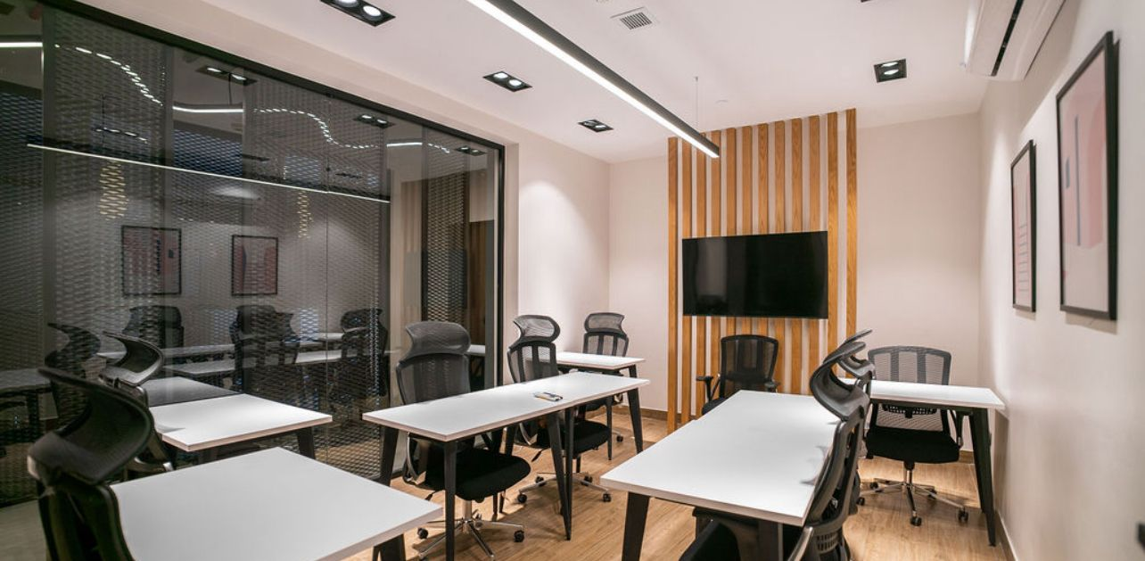
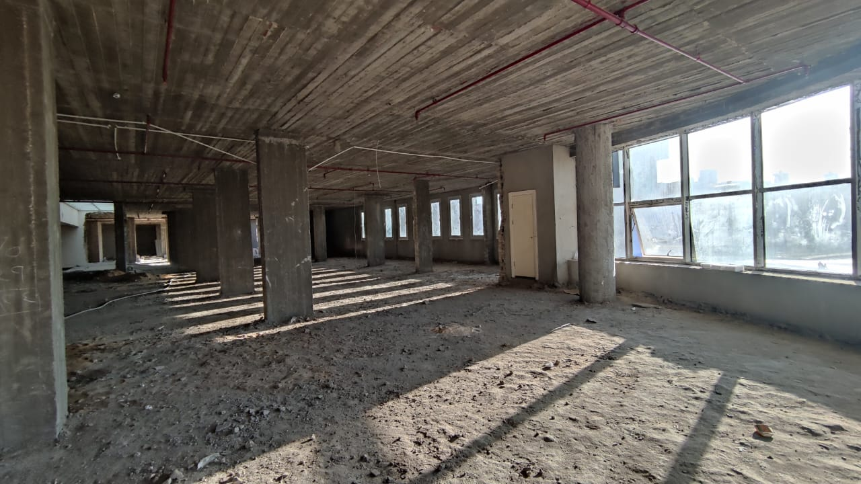
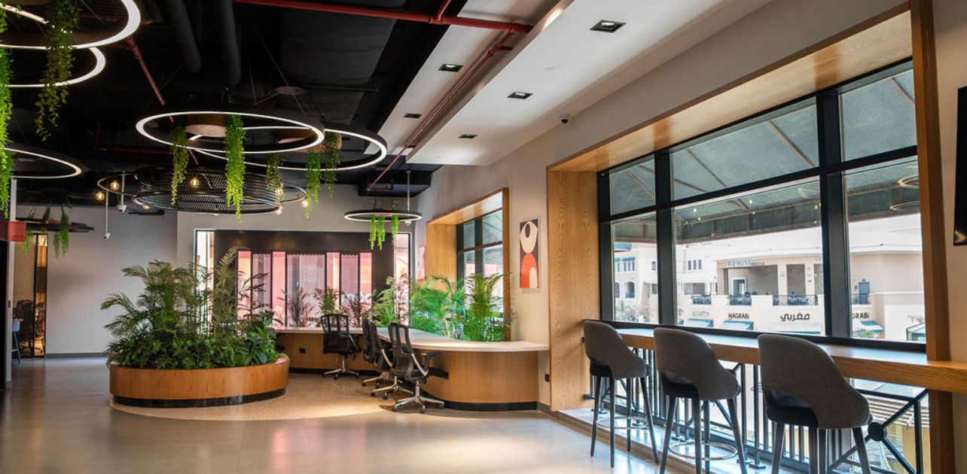
Interior picture

